Slide 1
Unit 3
Universal Internet Browsing

Slide 2
Internet Browsing
In digital communications media, the vast majority of participants are active creators of information as well as recipients.
Computer network applications such as electric mailing lists, conferences and bulletin boards, serve as a medium of group or many to many communication
The Internet provides universal access, giving the same powerful capabilities to everyone who has access to the network no matter where they are.
The Web is simply a large number of computers linked together in a global network, that can be accessed using an address
Exploration of the World Wide Web by following one interesting link to another, usually with a definite objective but without a planned search strategy. In comparison 'surfing' is exploration without a definite objective or search strategy, and 'searching' is exploration definite in both objective and strategy.

Slide 3
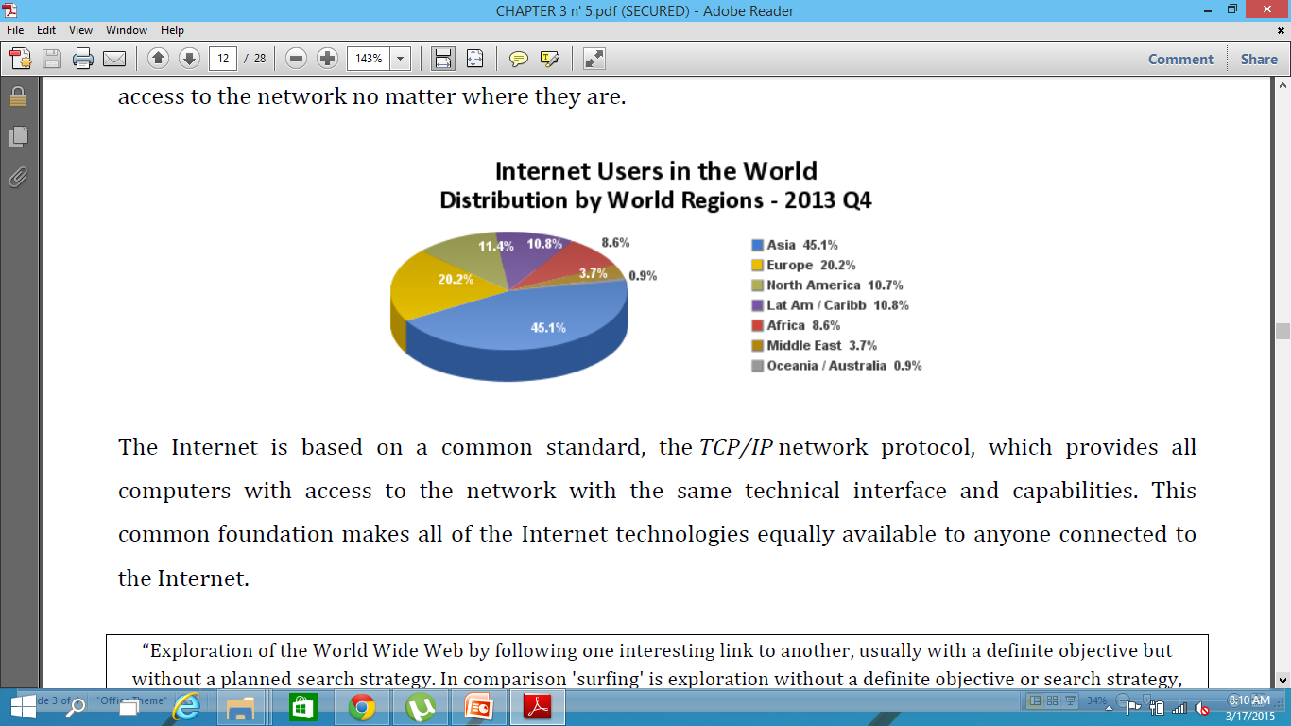

Slide 4
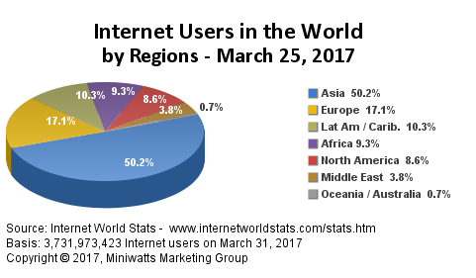

Slide 5
Internet Services
Participate in off-line discussions via e-mail with people with similar interests through 'mailing lists' and 'News Groups'.
Participate live (in real time) in a conversation with another person via the 'Internet video phone' (like Skype), or audio-video conferencing between multiple people using a specially designed computer programs and equipment.
Participate in on-line (directly, in real time) written discussion with a larger group of people who use the 'Internet Relay Chat' (IRC) service - chat rooms.
To work on a remote computer using the 'Telnet' service or some per function quite the same.
Take files of any type (download) from remote computers and deliver files (upload) them with an FTP service.
Read multimedia documents found on WWW (World Wide Web) that contain text, graphics, sound, and video using intelligent browser web presentation, as 'Google Chrome', 'Firefox' or 'Internet Explorer' program support.
Learning and practicing for the exam and achieve appropriate certification.
Search the Web, documents, various WWW sites or via dedicated international service, as 'Google' and 'Yahoo!', over subscribed keywords to find the desired documents.
Publicly disclose their images or pictures of his grandchildren, and who wants to can publish a picture of mother in law.
Advertise your business in a variety of ways, from setting up video clips to the creation of their own website.
Paying bills through the 'Internet Banking‘, Buy and spend money , advertise and offer for sale.
Read web editions of newspapers or say 'IT Alphabet‘.

Slide 6
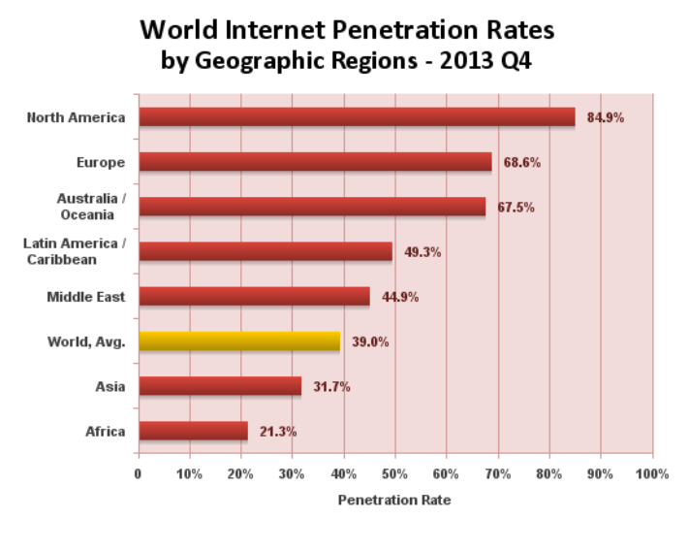

Slide 7
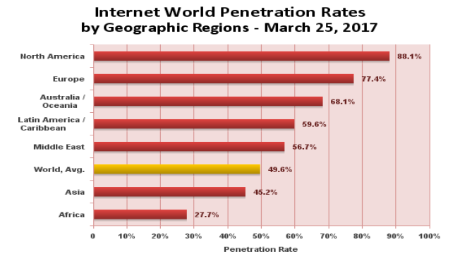
http://www.internetworldstats.com/stats.htm
http://www.internetlivestats.com/internet-users/

Slide 8
Nepal Internet users
4,962,323
Internet Users in Nepal (2016*)
Share of Nepal Population: 17.2 % (penetration)
Total Population : 28,850,717
Share of World Internet Users: 0.1 %
Internet Users in the World: 3,424,971,237

Slide 9
